Slide 1
Summary
Special Topics:
Beam-Driven Plasma Accelerators with Focus on p⁺-Driven (AWAKE, …)
Edda Gschwendtner, Patric Muggli
1

Slide 2
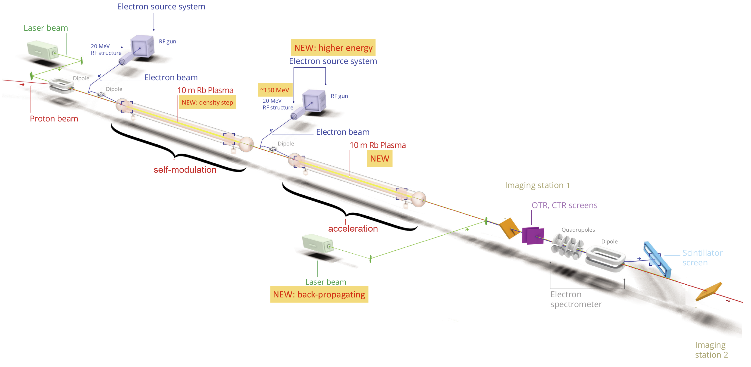
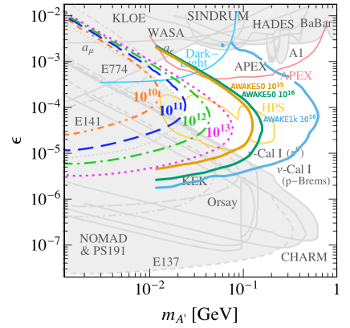
TEN-YEAR PLAN
Clear ten-year plan towards first application to particle physics
High-energy p⁺(400GeV, 7TeV) bunch (19, 112kJ) driver available
~100GeV e⁻ for dark photon searches in early 2030’s
International Collaboration
2016-19, successful Run 1
Reproducible self-modulation (SM) of the p⁺ bunch in plasma
Acceleration of externally injected, 19MeVe⁻ to 2GeV
2021-22, Run 2a
Demonstration of seeding of SM with e⁻ bunch (completed)
2023-24, Run 2b
Operation with discharge plasma source
Plasma density step for maintaining amplitude of wakefields over long distance
2028-.. Run 2c
External injection of e⁻ bunch for acceleration, with quality, at the 10GeV level: Q, ∆E/E, ε
2030-... Run 2d
Scalability of energy gain with plasma length
Ongoing
Development of scalable plasma sources: discharge, helicon source
Exploration of injectors: RF-gun, LWFA, foil
Development of the physics case
Very-high-energy ep, eA collider
Physics studies
Hosing instability, ramps, tolerances, etc.

